Slide 1
MATERIALITY AND AUDIT RISKS
(ISA, TEXT BOOKS, ARTICLES)
An auditor should consider materiality and its relationship with audit risks when performing an audit.
What is materiality?
“information is material if its omission, or misstatement could influence the economic decisions of users taken on the basis of the financial statements. Materiality depends on the size of the item, or error judged in the particular circumstances of its omission or misstatement. Thus, materiality provides a threshold or cut-off point rather than being a primary qualitative characteristic which information must have if it is to be useful.”

Slide 2
MATERIALITY AND AUDIT RISKS
(ISA, TEXT BOOKS, ARTICLES)
Subject to compliance with legal and statutory requirements, auditor’s assessment of materiality is a matter of professional judgment.
Materiality should be considered by auditor when:
Determining the nature, timing and extent of audit procedures.
Evaluating the effects of misstatements.

Slide 3
MATERIALITY AND AUDIT RISKS
(ISA, TEXT BOOKS, ARTICLES)
Preliminary judgment about materiality levels used in planning the audit may differ from materiality levels used at the conclusion of the audit in evaluating audit findings because surrounding circumstances may change and additional information about entity is obtained.
Materiality involve both quantitative and qualitative considerations.

Slide 4
MATERIALITY AND AUDIT RISKS
(ISA, TEXT BOOKS, ARTICLES)
In planning the audit, auditor should assess materiality at:
Financial report level.
Because auditor’s opinion on true and fairness extends to the financial report taken as a whole.
Account balance and class of transactions level.
Because auditor verifies account balances in reaching the overall audit conclusion on the financial statements.

Slide 5
MATERIALITY AND AUDIT RISKS
(ISA, TEXT BOOKS, ARTICLES)
In making a preliminary judgment about materiality, auditor initially determines the aggregate (overall) level of materiality for each financial statement.
For planning purposes, the auditor uses the smallest aggregate level of misstatements considered to be material to any one of the financial statements.

Slide 6
MATERIALITY AND AUDIT RISKS
(ISA, TEXT BOOKS, ARTICLES)
Materiality at account balance level
Also known as tolerable misstatement.
Materiality Concept – pertains to the amount of misstatement that could affect users’ decision.
Material Account Balance – refers to the size of a recorded account balance.
Accounts with seemingly immaterial balance may contain understatements that exceed materiality.

Slide 7
MATERIALITY AND AUDIT RISKS
(ISA, TEXT BOOKS, ARTICLES)
Financial Statement Materiality
In allocating financial statement materiality, auditor will choose to allocate relatively larger amounts to accounts that have a higher likelihood of misstatements and are more costly to audit.

Slide 8
MATERIALITY AND AUDIT RISKS
(ISA, TEXT BOOKS, ARTICLES)
Relationship between materiality and audit evidence
The lower the materiality level for an account balance, the greater the amount of evidence needed (inverse relationship)
The larger or more significant an account balance, the greater the amount of evidence needed (direct relationship)

Slide 9
MATERIALITY AND AUDIT RISKS
(ISA, TEXT BOOKS, ARTICLES)
RM0 RM30,000 RM50,000 RM1,000,000
Materiality Level A Materiality Level B Total inventories
IF THE MATERIALITY LEVEL IS SET AT A LOW LEVEL, MORE EVIDENCES ARE NEEDED FOR US
TO REASONABLY SAY THAT, THERE IS NO MATERIAL MISSTATEMENTS WITHIN THE BALANCE.

Slide 10
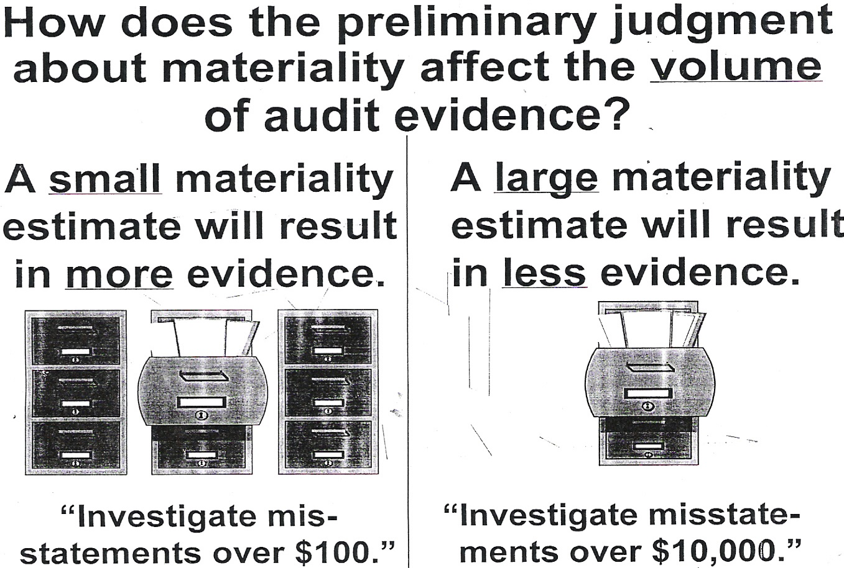
MATERIALITY AND AUDIT RISKS
(ISA, TEXT BOOKS, ARTICLES)

Slide 11
MATERIALITY AND AUDIT RISKS
(ISA, TEXT BOOKS, ARTICLES)
Examples of Quantitative Guidelines On Materiality Application at the financial Statement Level
5% to 10% of profit before tax
0.5% to 1% on total assets
10% on equity
0.5% to 1% on gross profit

Slide 12
MATERIALITY AND AUDIT RISKS
(ISA, TEXT BOOKS, ARTICLES)
When auditor’s preliminary judgment about financial statement materiality are quantified, a preliminary estimate of materiality for each account may be obtained by allocating financial statements materiality to the individual accounts.
In making the allocation, auditor should consider:
Likelihood of misstatements in the account.
Probable costs of verifying the account.

Slide 13
MATERIALITY AND AUDIT RISKS
(ISA, TEXT BOOKS, ARTICLES)
Example: Balance Sheet
Balance (RM) Percentage
Cash 500,000 5%
Accounts Receivable 1,500,000 15%
Inventory 3,000,000 30%
Plant Assets 5,000,000 50%
10,000,000 100%

Slide 14
MATERIALITY AND AUDIT RISKS
(ISA, TEXT BOOKS, ARTICLES)
Based on previous experience with client, auditor anticipates few misstatements in cash, plant assets, and some misstatements in accounts receivable and inventories. Based on experience too, auditor expects cash and plant assets accounts will be significantly less costly to audit than other accounts.
Assuming the preliminary estimate of financial statement materiality is 1% of total assets i.e. RM100,000, consider the alternative allocation of plans:-

Slide 15
MATERIALITY AND AUDIT RISKS
(ISA, TEXT BOOKS, ARTICLES)
Example: Materiality Allocation
Plan A(RM) % Plan B(RM) %
Cash 5,000 5 2,000 2
Accounts Receivable 15,000 15 18,000 18
Inventory 30,000 30 50,000 50
Plant Assets 50,000 50 30,000 30
100,000 100,000

Slide 16
MATERIALITY AND AUDIT RISKS
(ISA, TEXT BOOKS, ARTICLES)
In Plan A: materially has been proportionately allocated to each accounts without regards to expected monetary misstatements or audit costs.
In Plan B: larger materiality allocations are made to receivables and inventories for which more misstatements are expected and the costs of detection are higher (thus the amount of evidence needed on these accounts is reduced compared to plan A, because of the inverse relationship between account balance materiality and evidence).
In effect, auditor is simply allowing for greater proportion of the total allowable misstatements to remain in those accounts where it would be most expensive to detect the misstatements.

Slide 17
MATERIALITY AND AUDIT RISKS
(ISA, TEXT BOOKS, ARTICLES)
What is Audit Risk?
“The auditor should obtain an understanding of the accounting and internal control sufficient to plan the audit and develop an effective audit approach. The auditor should use professional judgment to assess audit risk and to design audit procedures to ensure that it is to an acceptably low level.”
(ISA400)

Slide 18
MATERIALITY AND AUDIT RISKS
(ISA, TEXT BOOKS, ARTICLES)
Audit Risk
“Risk that the auditor may express an inappropriate audit opinion when the financial report is materially misstated.”
Therefore, auditor need to restrict the audit risk at the account balance level so that at the conclusion of an audit, the audit risk in expressing an opinion on the financial report as a whole, will be at an appropriately low level.

Slide 19
MATERIALITY AND AUDIT RISKS
(ISA, TEXT BOOKS, ARTICLES)
Audit Risk has three components:
Inherent Risk
Control Risk
Detection Risk
In setting desired audit risk, the auditor seeks a balance between costs associated with incorrect audit opinion AND costs of performing additional audit procedures to reduce audit risk.

Slide 20
MATERIALITY AND AUDIT RISKS
(ISA, TEXT BOOKS, ARTICLES)
OVERALL AUDIT RISK
Factors Influencing Assessment of the Overall Audit Risk
Business and industry
Integrity of management
Legal and financial stability
Control environment and operation
Intended users of financial statements

Slide 21
MATERIALITY AND AUDIT RISKS
(ISA, TEXT BOOKS, ARTICLES)
INHERENT RISK
“The susceptibility of an account balance or class of transactions to misstatements assuming they are no related internal control structure, policies and procedures.”
Assessment of inherent risk requires consideration of factors that may have a pervasive effect on assertions for all or many of the accounts such as going concern status, management turnover, impact of technological development, complex calculations, contentious accounting issues.

Slide 22
MATERIALITY AND AUDIT RISKS
(ISA, TEXT BOOKS, ARTICLES)
INHERENT RISK
The assessed level of inherent risk is based on the auditor’s evaluation of inherent risk factors. The auditor may forgo the evaluation and simply assess inherent risk at the maximum level when the auditor concludes that the effort required to evaluate inherent risk for an assertion will exceed the benefits from using a lower misstatement.

Slide 23
MATERIALITY AND AUDIT RISKS
(ISA, TEXT BOOKS, ARTICLES)
CONTROL RISK
“is the risk that a material misstatement can occur in an account balance or class of transactions that will not be prevented or detected on a timely basis by the entity’s internal control structure policies and procedures.”
Control risk can never be zero because internal controls cannot provide complete assurance that all material misstatements will be prevented or detected.

Slide 24
MATERIALITY AND AUDIT RISKS
(ISA, TEXT BOOKS, ARTICLES)
CONTROL RISK
Auditors determined the planned assessed level of control risk for each significant assertions in the planning phase of the audit based on assumptions about effectiveness of design and operations of relevant portions of internal control structure.
An actual assessed control risk is subsequently determined based on evidence obtained from auditor’s study and evaluation of internal control structure during interim work.

Slide 25
MATERIALITY AND AUDIT RISKS
(ISA, TEXT BOOKS, ARTICLES)
DETECTION RISK
“is the risk that the auditor may not detect a material misstatements that exist in an account balance or class of transactions.”
Unlike inherent and control risks, auditor can change the actual level of detection risk by varying the nature, timing and extent of substantive procedures to be performed on an assertion. Low detection risk imply the use of more effective procedures, perform nearer to interim date, perform on larger sample size.

Slide 26
MATERIALITY AND AUDIT RISKS
(ISA, TEXT BOOKS, ARTICLES)
DETECTION RISK
Planned acceptable level of detection risk is determined for each significant assertion in the planning stage of the audit. This planned level may subsequently be revised based on evidence obtained about effectiveness of relevant internal controls.

Slide 27
MATERIALITY AND AUDIT RISKS
(ISA, TEXT BOOKS, ARTICLES)
The three components of audit risk can be expressed in quantitative terms (eg: percentages) OR in non-quantitative forms (eg: low, moderate, high, maximum).
It expresses the relationship between the components as:
AR = IR X CR X DR
and solves for detection risk using the variation
DR = AR
(IR X CR)

Slide 28
MATERIALITY AND AUDIT RISKS
(ISA, TEXT BOOKS, ARTICLES)
Relationships Between Audit Risks and Audit Evidence
The lower the overall audit risk to be achieved, the greater the amount of evidence required (inverse r/ship)
For a given level of audit risks, the lower the acceptable level of audit risk, the greater the amount of evidence required (inverse r/ship)
Conversely, the lower the assessed levels of inherent and control risks, the lesser the amount of evidence needed.

Slide 29
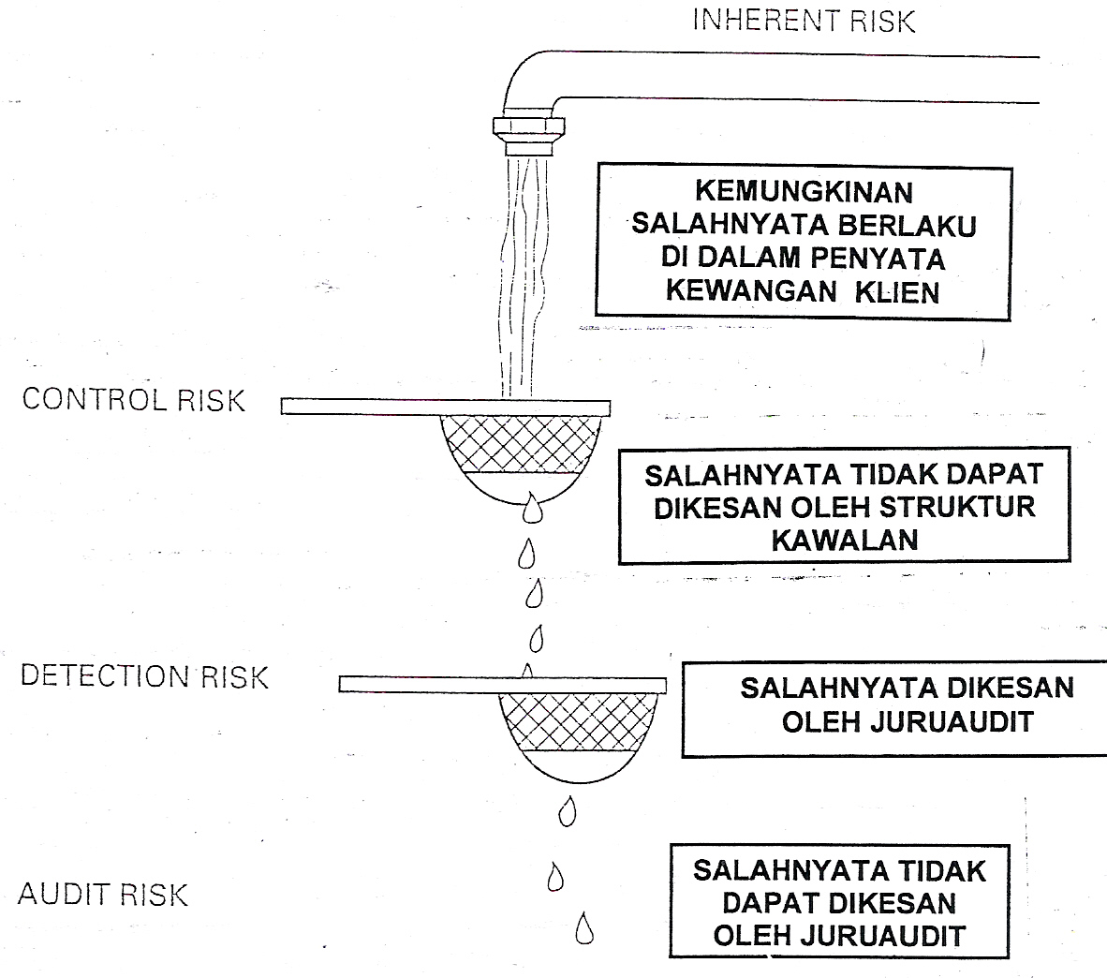
MATERIALITY AND AUDIT RISKS
(ISA, TEXT BOOKS, ARTICLES)

Slide 30
MATERIALITY AND AUDIT RISKS
(ISA, TEXT BOOKS, ARTICLES)
INTER-RELATIONSHIPS
Audit Evidence
Materiality Level Audit Risk

Slide 31
MATERIALITY AND AUDIT RISKS
(ISA, TEXT BOOKS, ARTICLES)
FROM AUDITOR’S PERSECTIVE:
The inherent and control risks existence independently from the audit work.
Why???
The levels of risk for both are very much influenced by client and the client’s environment. Therefore, auditor has less control over them.

Slide 32
MATERIALITY AND AUDIT RISKS
(ISA, TEXT BOOKS, ARTICLES))
FROM AUDITOR’S PERSECTIVE:
Detection Risk can be controlled by auditor through scope of work and audit procedures conducted.
AT THE END OF AUDIT WORK:
Actually, the real level of audit risk is not known.
Therefore: If auditor assesses that audit risk achieved is equal or less than the planned audit risk, an unqualified report can be issued (if not, extend audit work or issue qualified report).

